Slide 1
SNPWG 11
Vision from Monaco 2009

Slide 2

Nautical information domain
Product specification
Scope
Feature Catalogue
Application schema
Define limit of dummy product
Simple data sets
Amend ECDIS kernel
7Cs ?
Jeppesen ?
Other ?
3 themes
Try in Inerschalt / Elsewhere

Slide 3
Nautical information domain
Product specification
Scope
Feature Catalogue
Application schema
Define limit of dummy product
S-64
Simple data sets
Themes

Slide 4
Steps
Write specimen NPs for Micklefirth
Plan an entry to discharge cargo
Map information to features and attributes in IHO Registry
Produce test data sets

Slide 5
Nautical information scope
Feedback
Try other themes
3 themes

Slide 6
Potential Themes
Pilotage
Radio signals
Marine Protected Area
Environmental conditions
  Perhaps choose one or two
Port

Slide 7
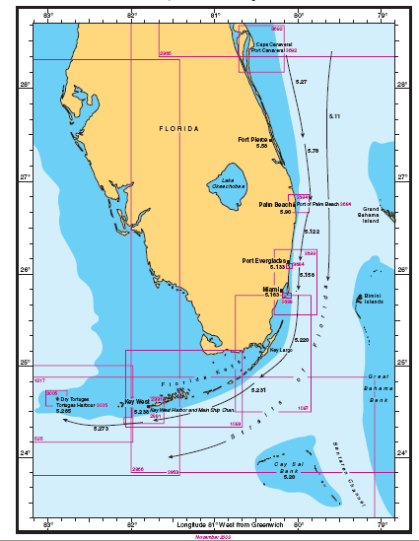

Slide 8
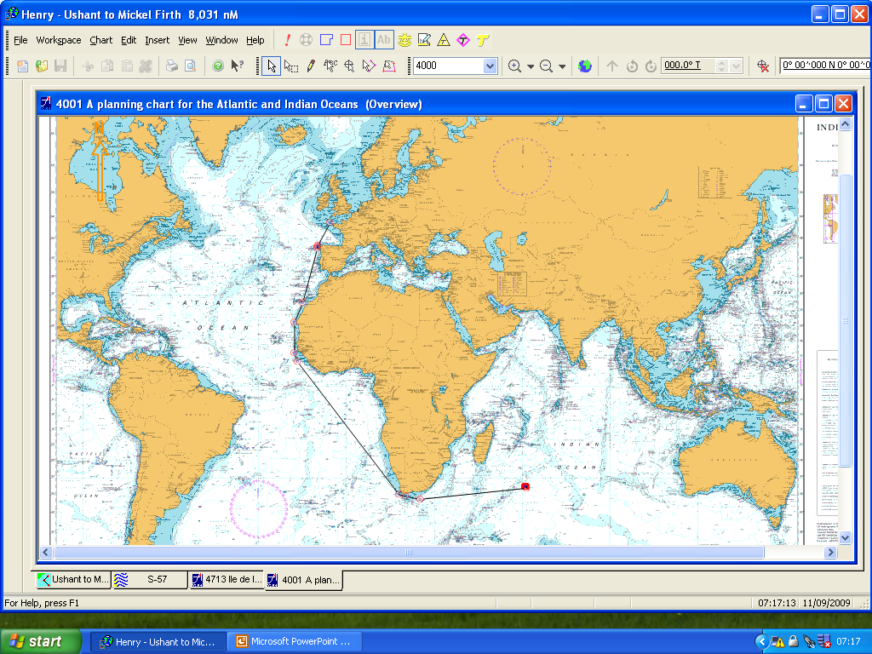

Slide 9
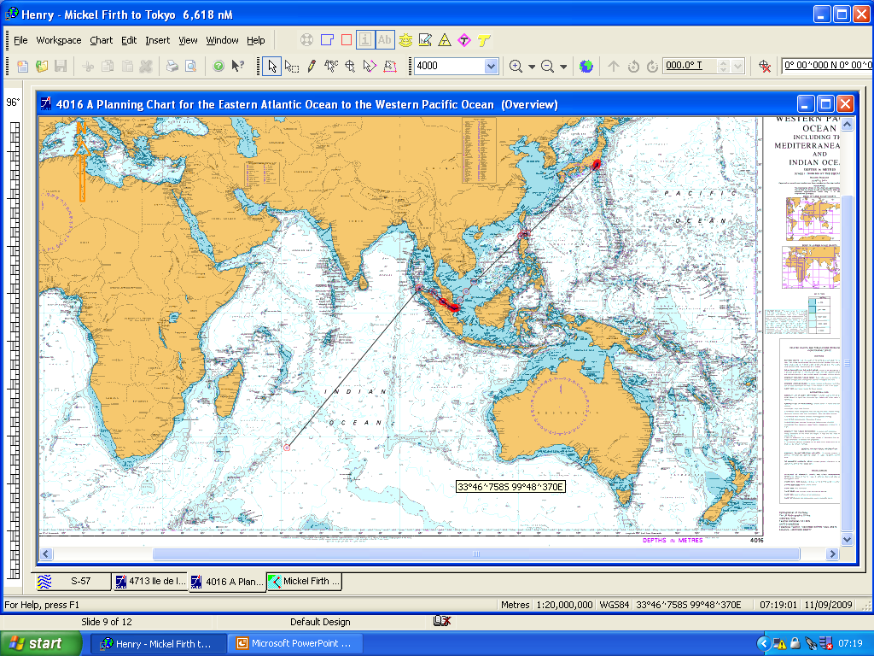
SNPWG 12
HSSC 1
SNPWG 11

Slide 10
Work item leads
Paper specimen product
  SDs David
  Radio signals Alain
  MPA Tom Craig Holly
  Natural conditions Mike
Create use cases
  Draft initial cases Ernie, John P, Raphael
  Develop cases ECDIS stakeholder forum
Model data found
  UML Ernie, Eivind
  Application schema
  Feature catalog
Data set Ernie, Eivind
Mock up candidate display

Slide 11
In parallel
Continue population of NPUBS Register
Develop new features and attributes in Wiki
  Refine by end September
  Agree by silence end October
Start process to change items in register from Invalid to Valid
  ( Paper for Tokyo )
Develop task for DIPWG
  Paper for Tokyo

